Slide 1
Stationery Store Project
Presented by:
Elghandour Abdelrahman

Slide 2
Table of contents
- Presenting website features and functionalities
- Presenting Excerpts of the code
- Presenting mistakes that I made.
- Lessons learnt while building the project

Slide 3
Website features

Slide 4
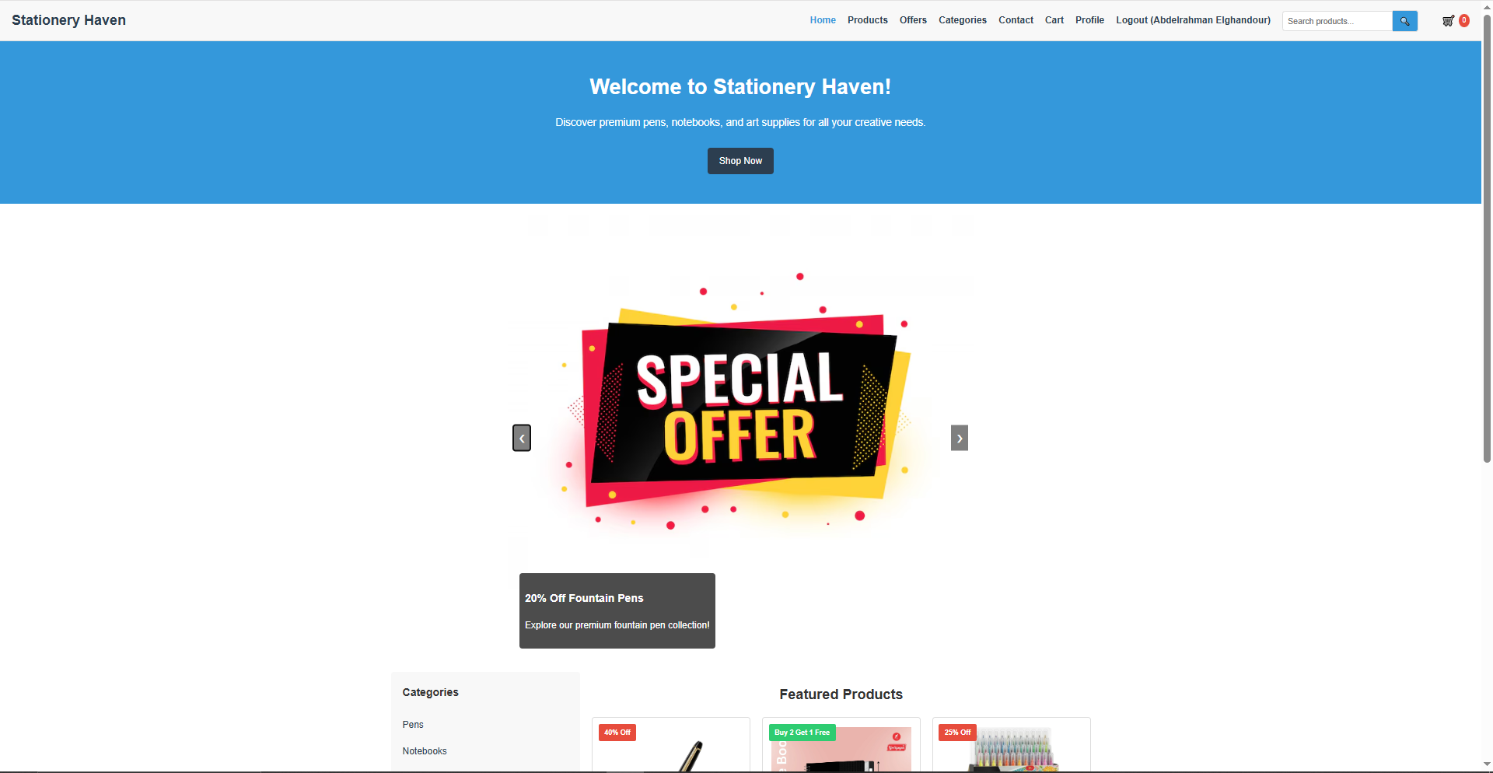
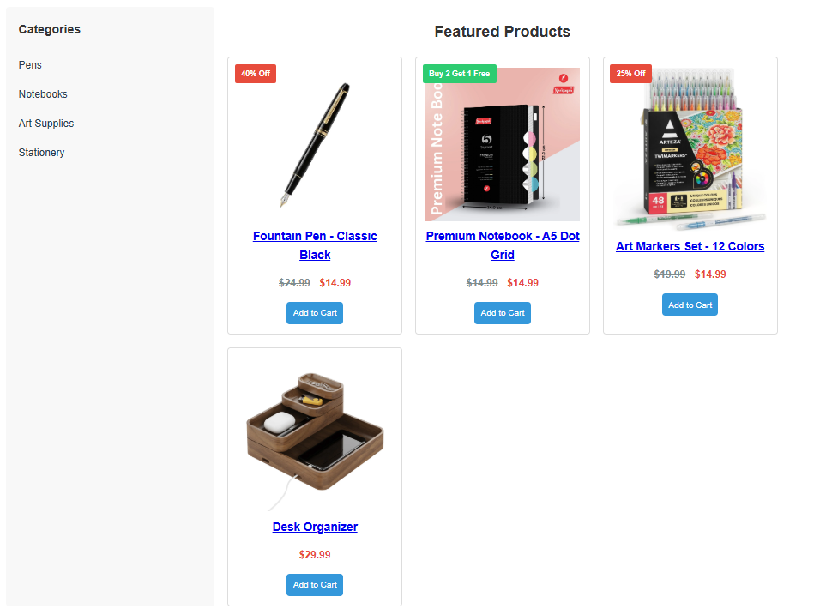
Website home page

Slide 5
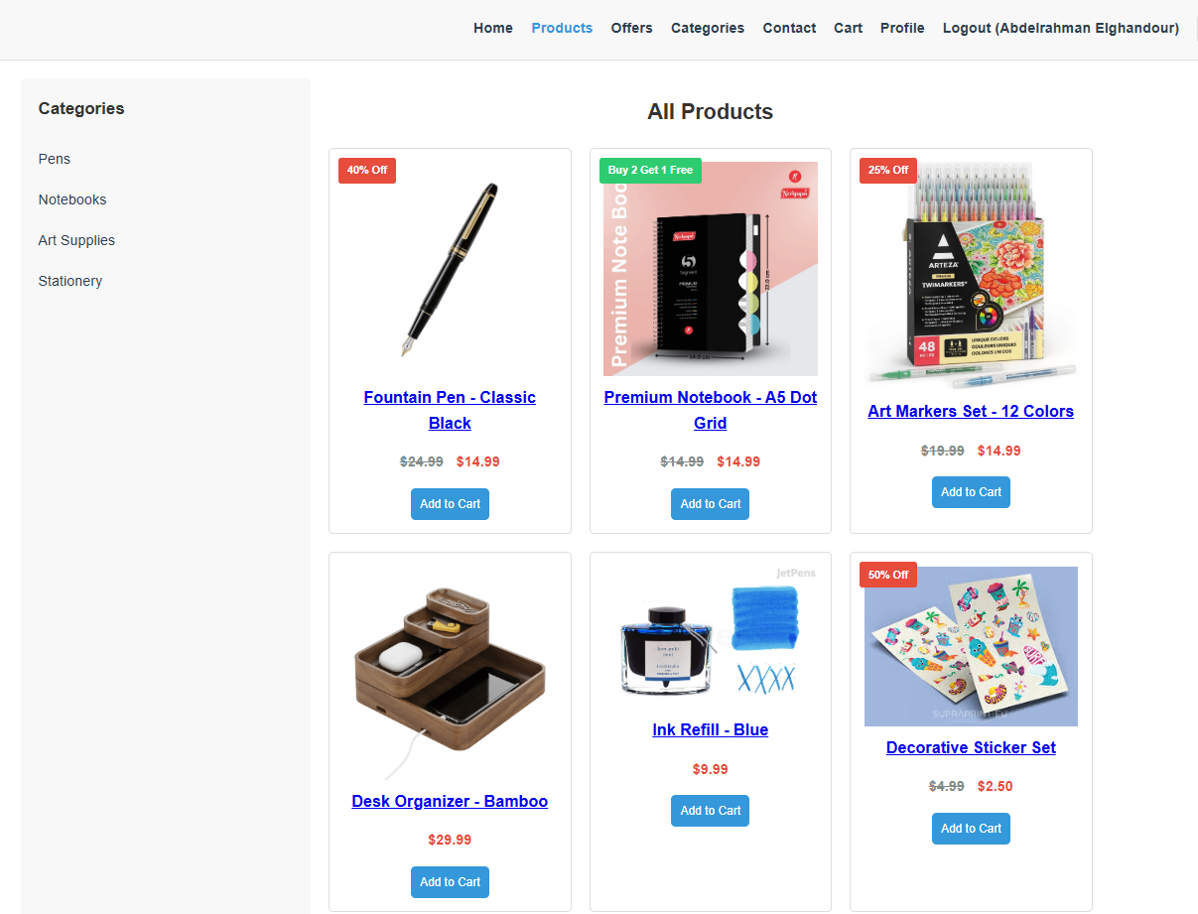
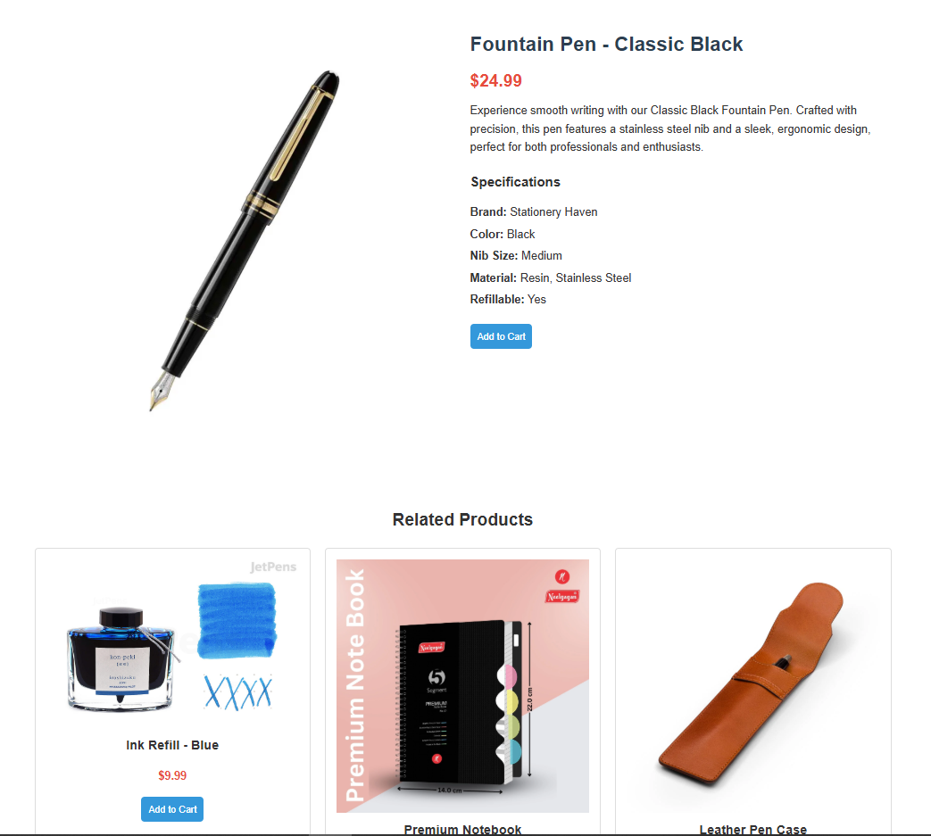
Header + products page + each product unique page

Slide 6
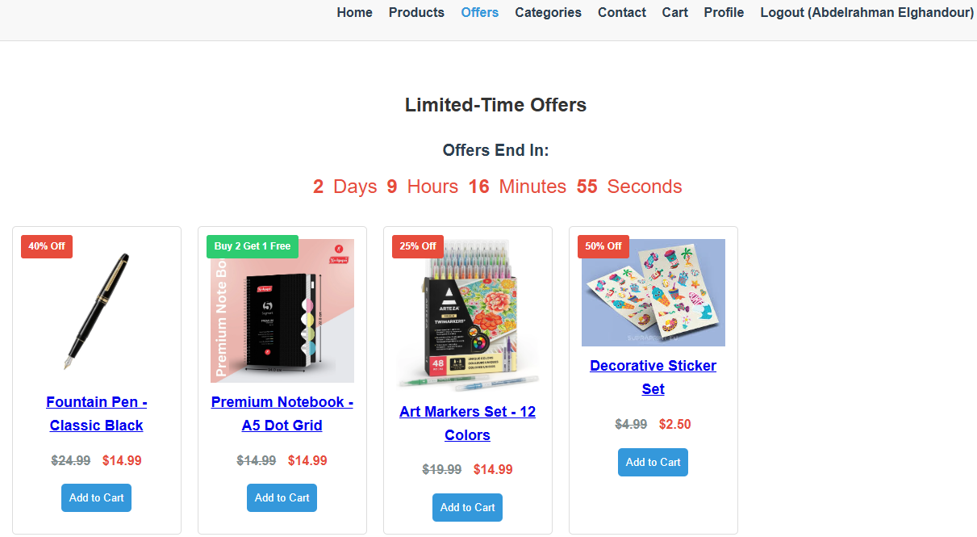
Offers page with limited time offers

Slide 7
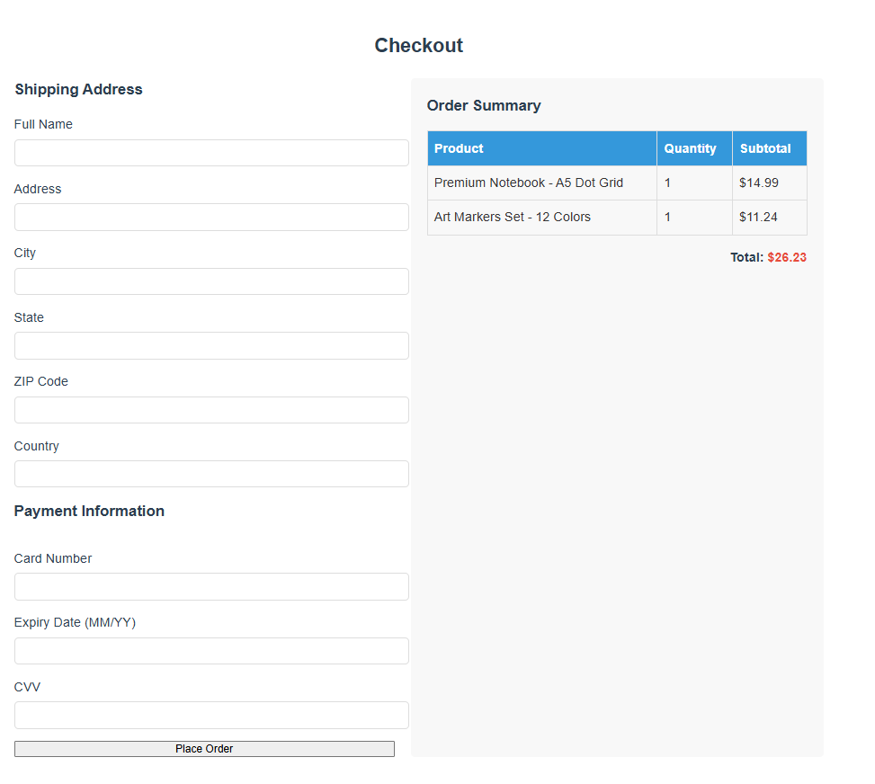
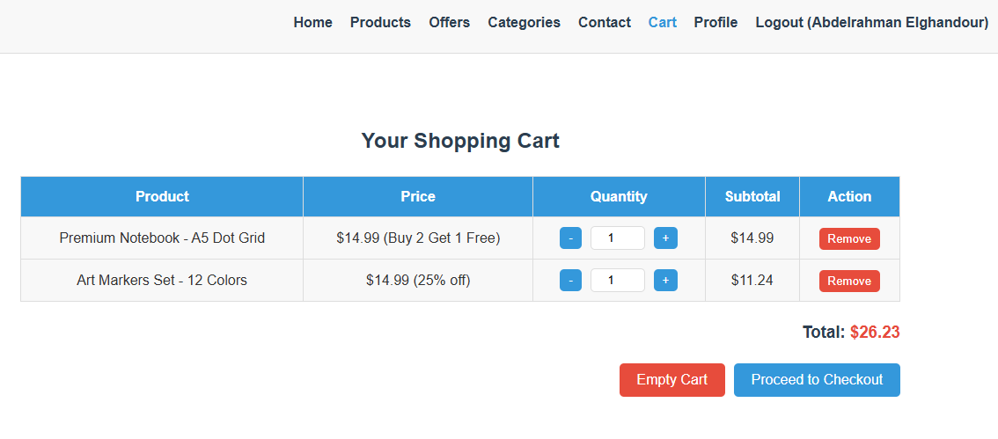
Cart and checkout pages

Slide 8
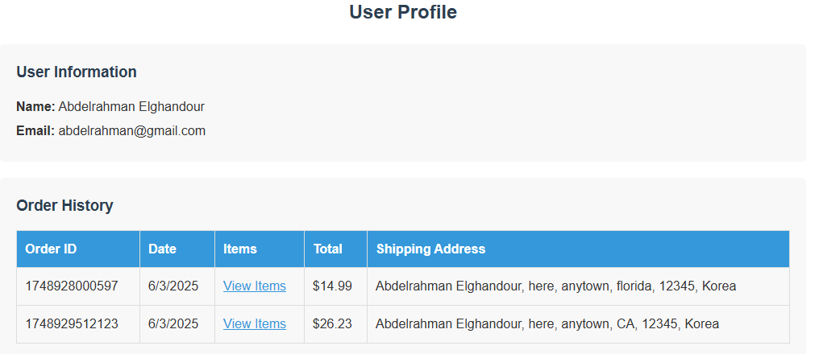
User profile and order history

Slide 9
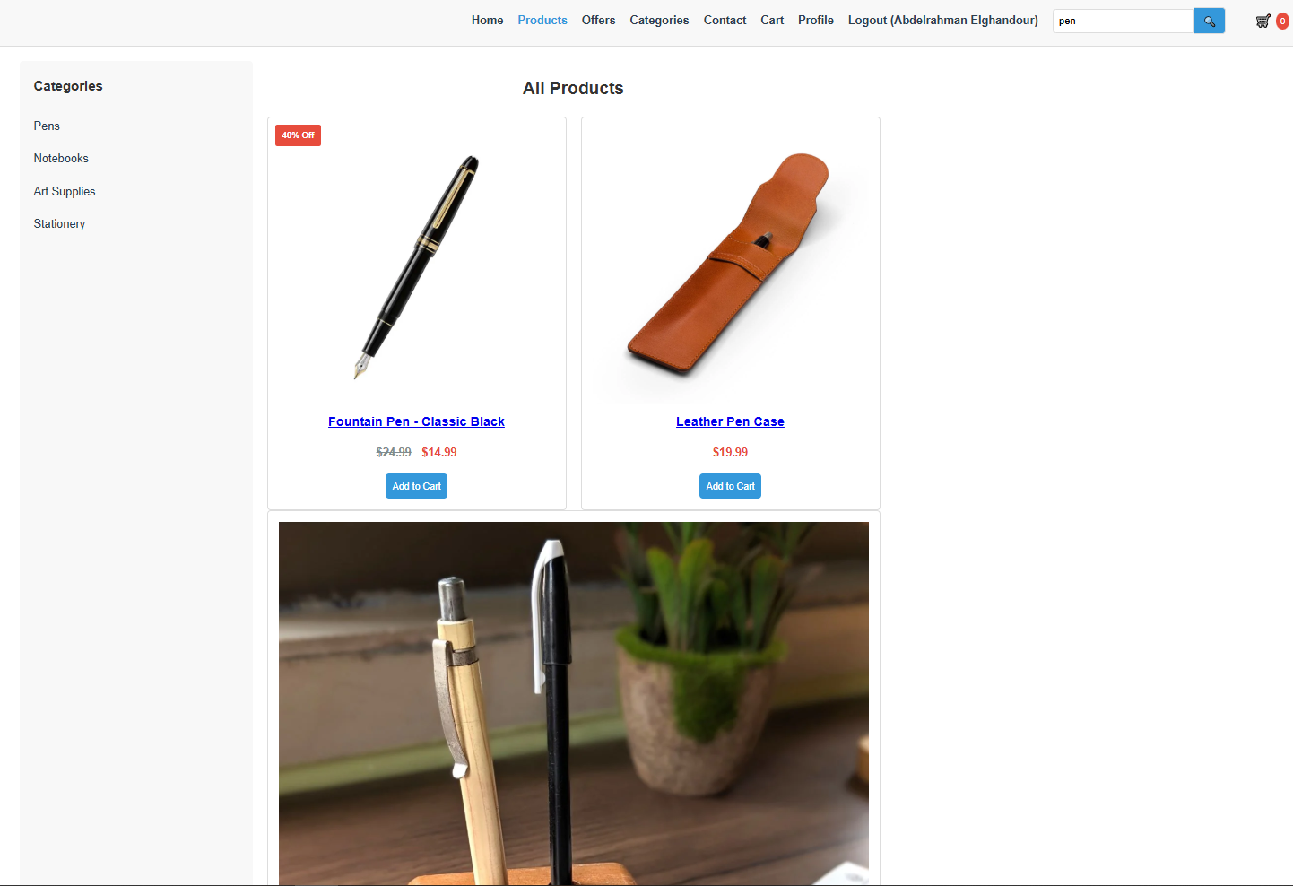
Search bar filtering

Slide 10
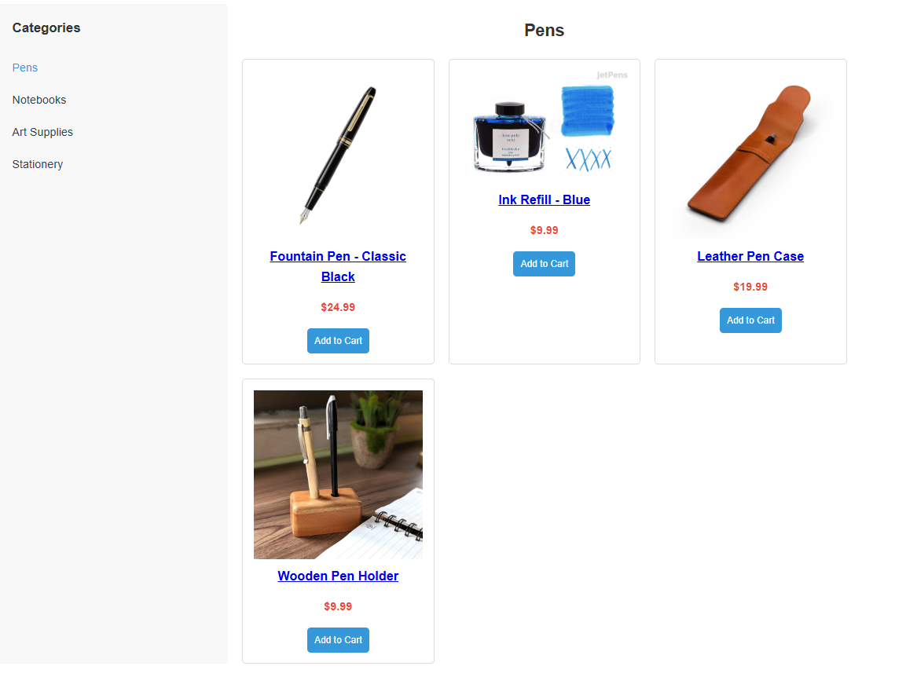
Category side bar

Slide 11
Code excerpts

Slide 12


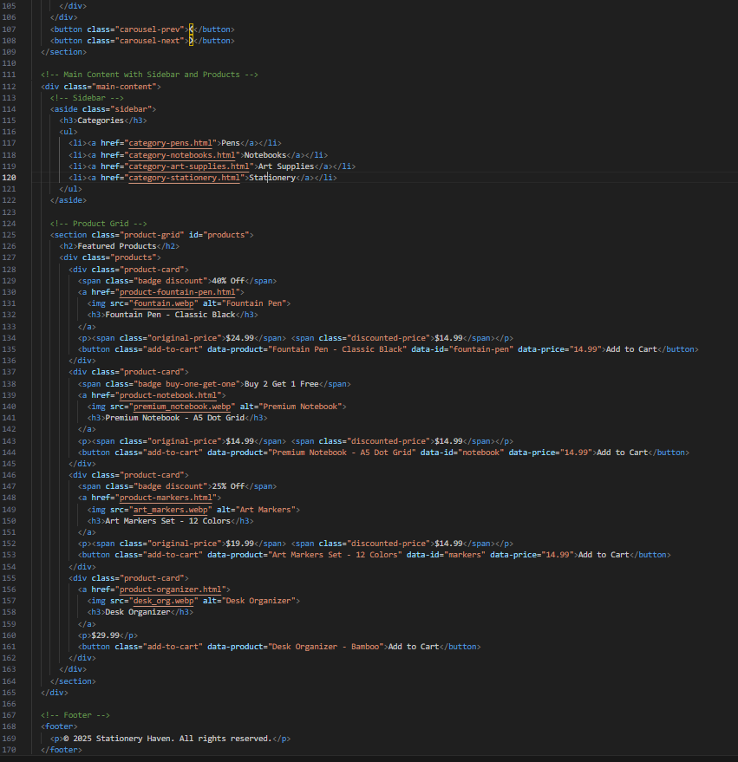
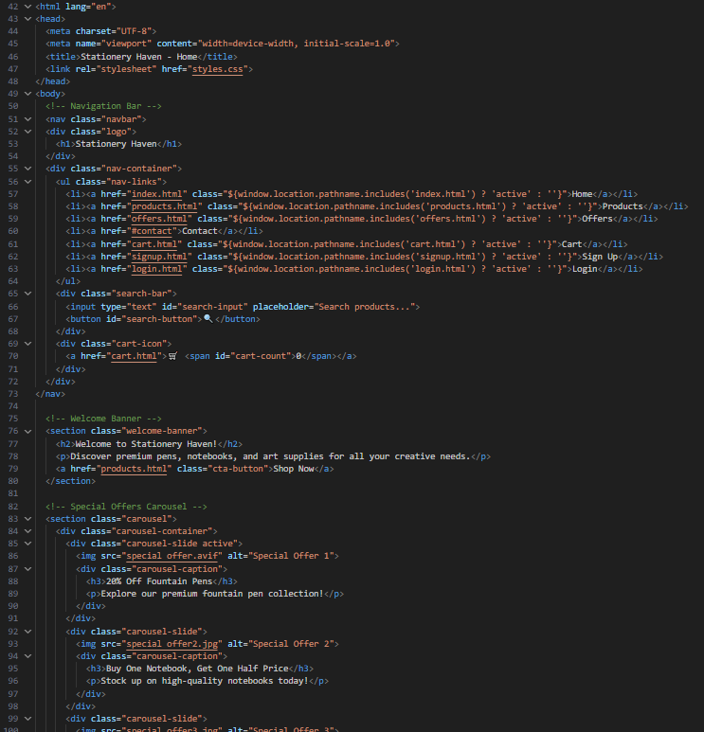

Index File

Slide 13
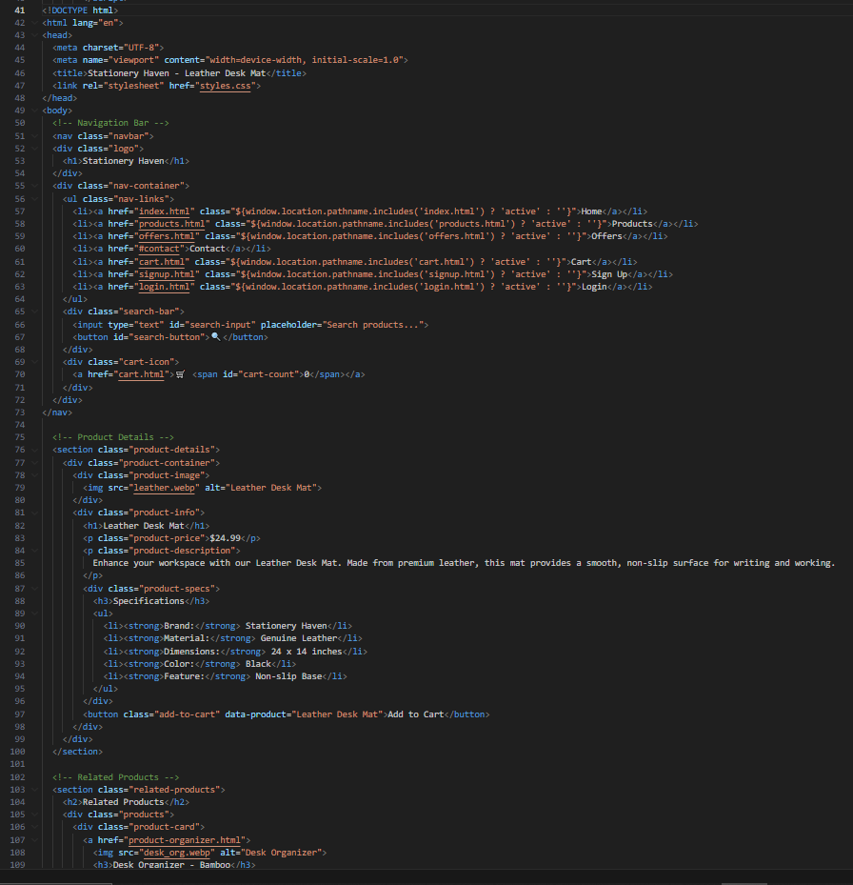
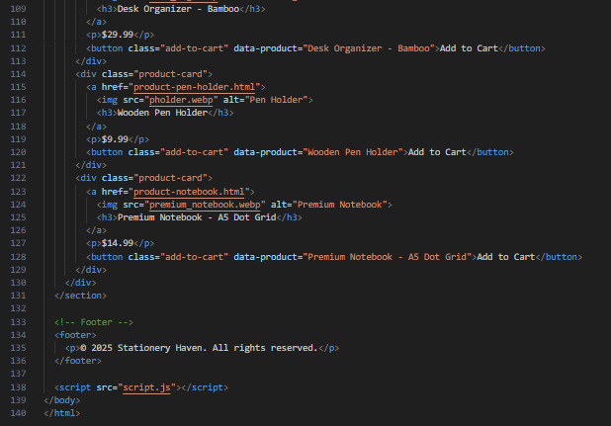
An Example of a product page

Slide 14
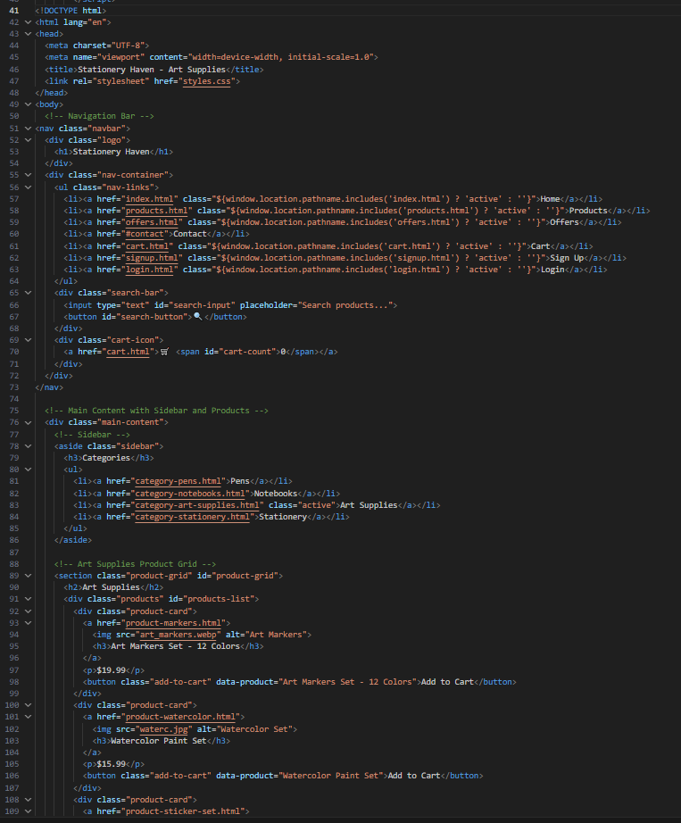
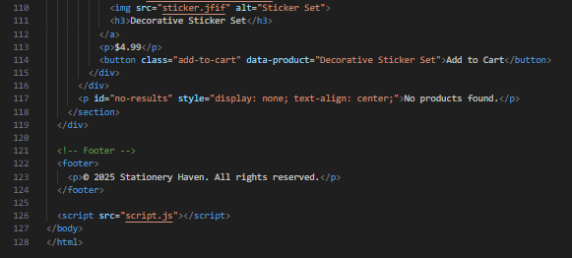
An example of a category page

Slide 15
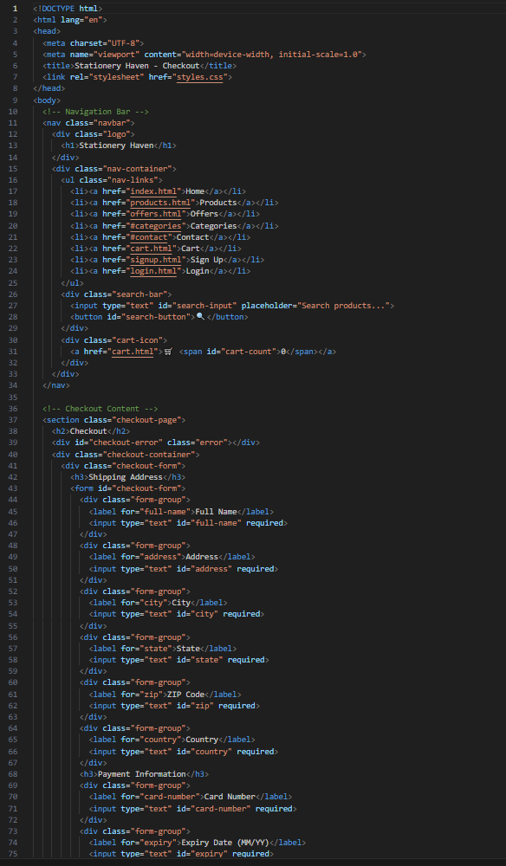
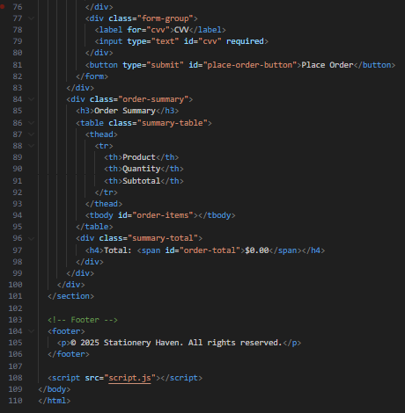
Checkout page

Slide 16
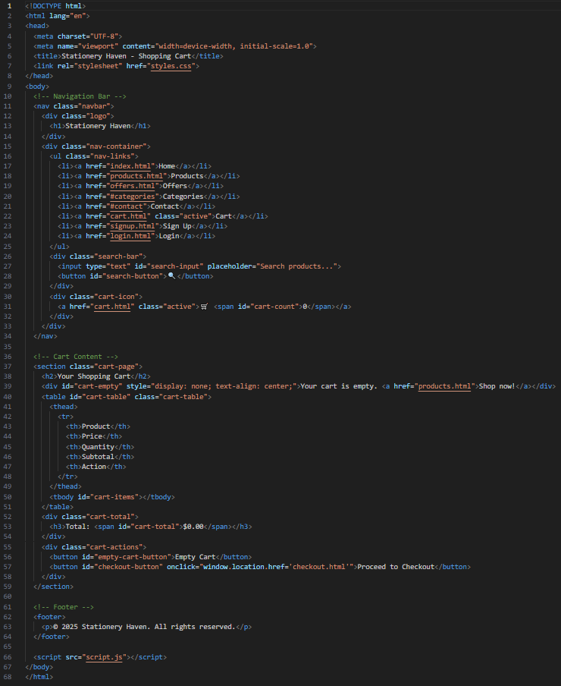
Cart page

Slide 17
CSS styling excerpts

Slide 18
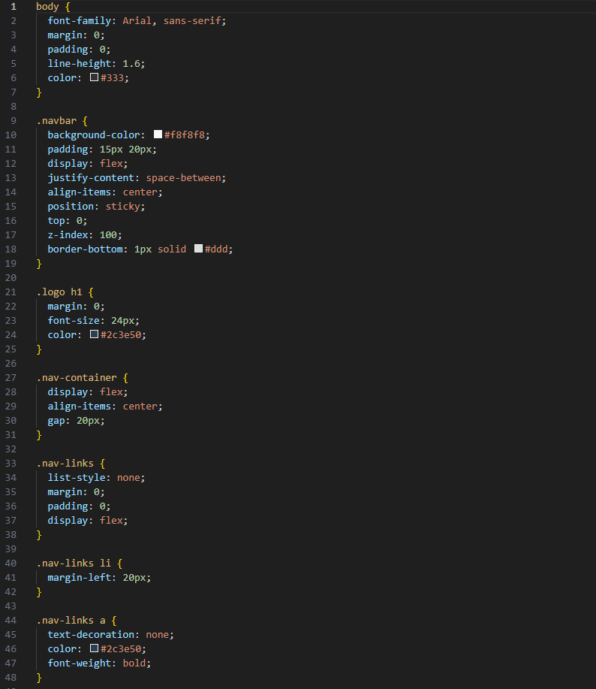
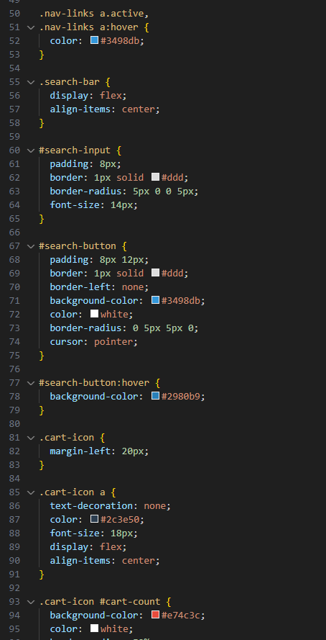
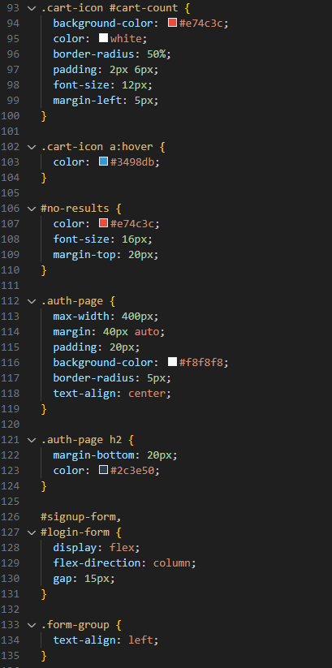

Slide 19
CSS code is almost 1000 lines of code, so it would be difficult to show all of it☹

Slide 20
JavaScript code excerpts

Slide 21
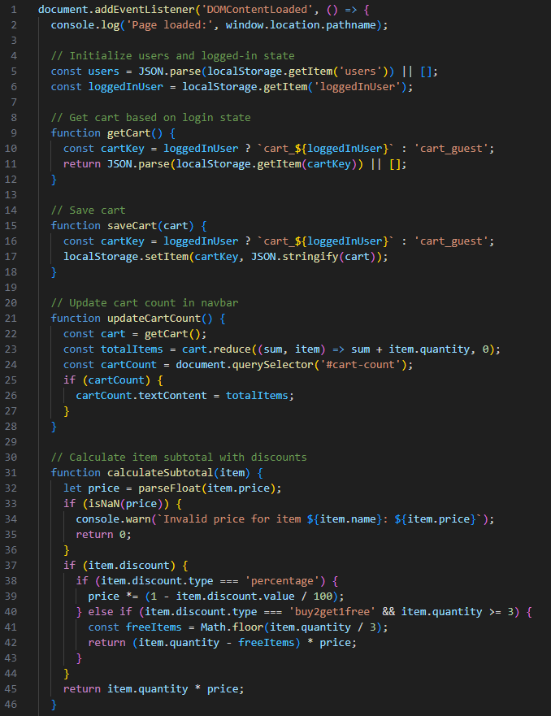
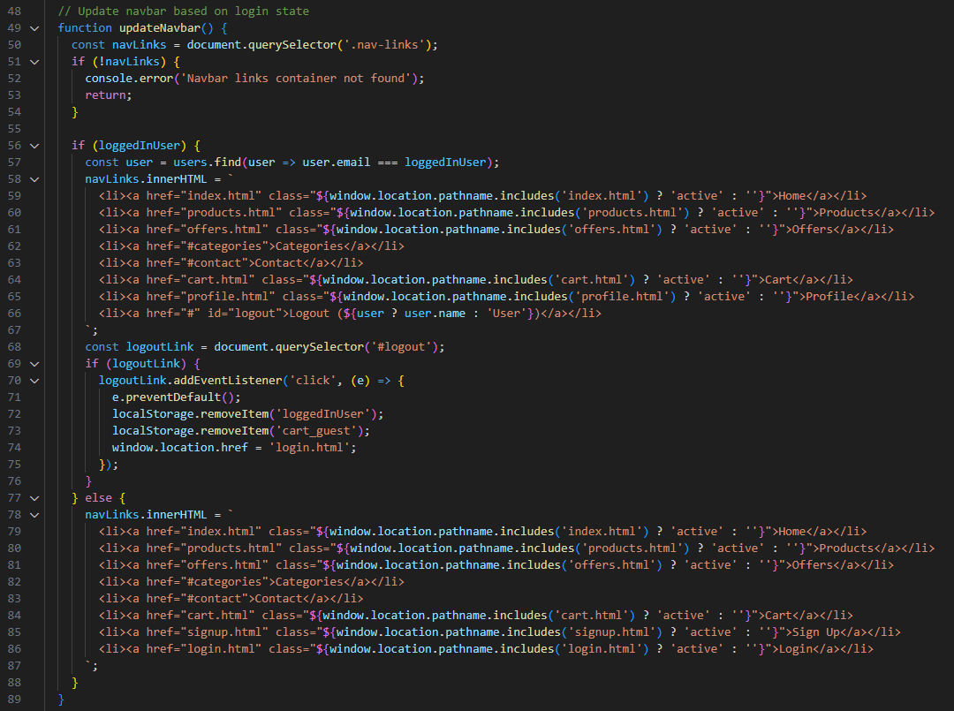

Slide 22
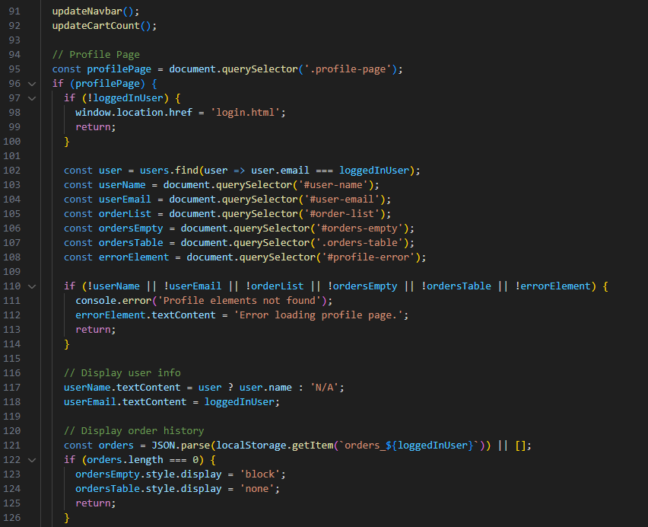
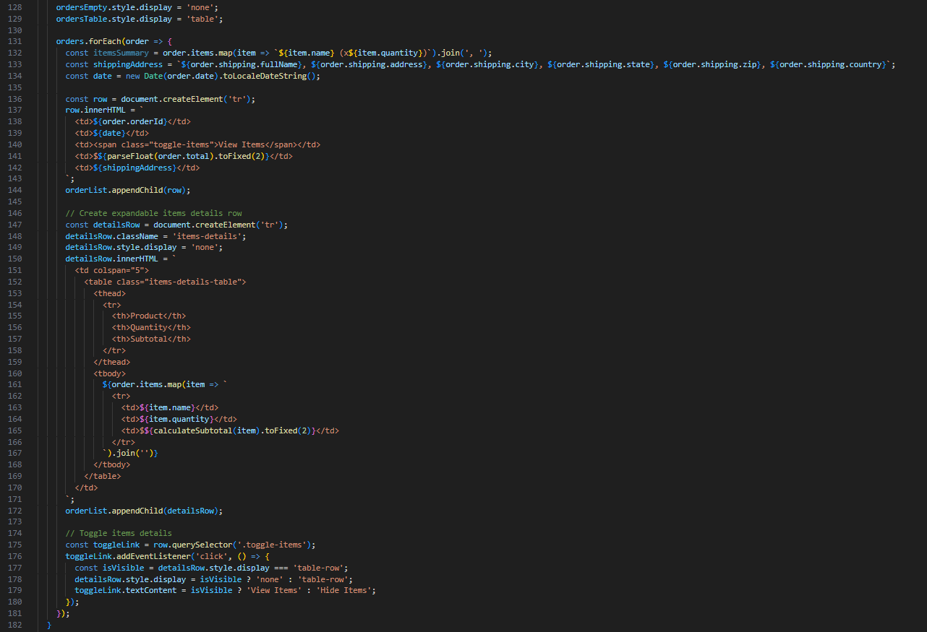

Slide 23
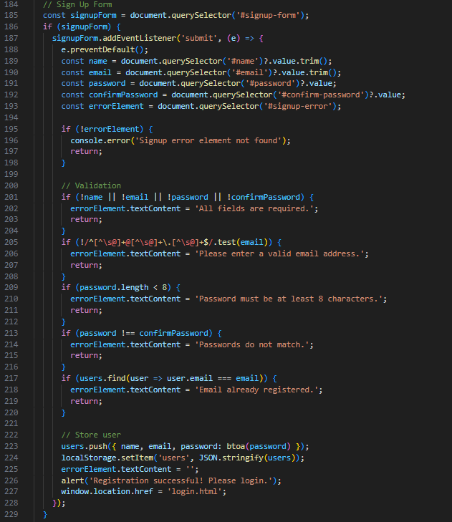
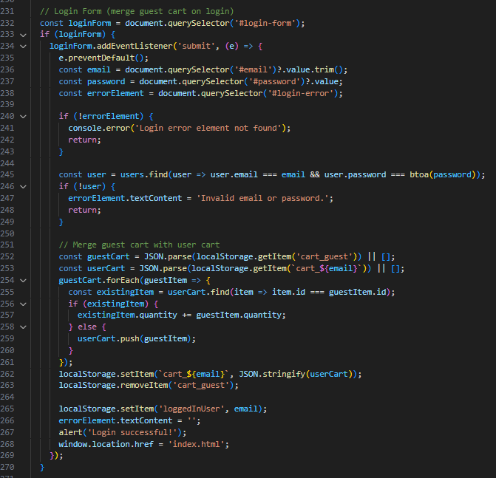

Slide 24
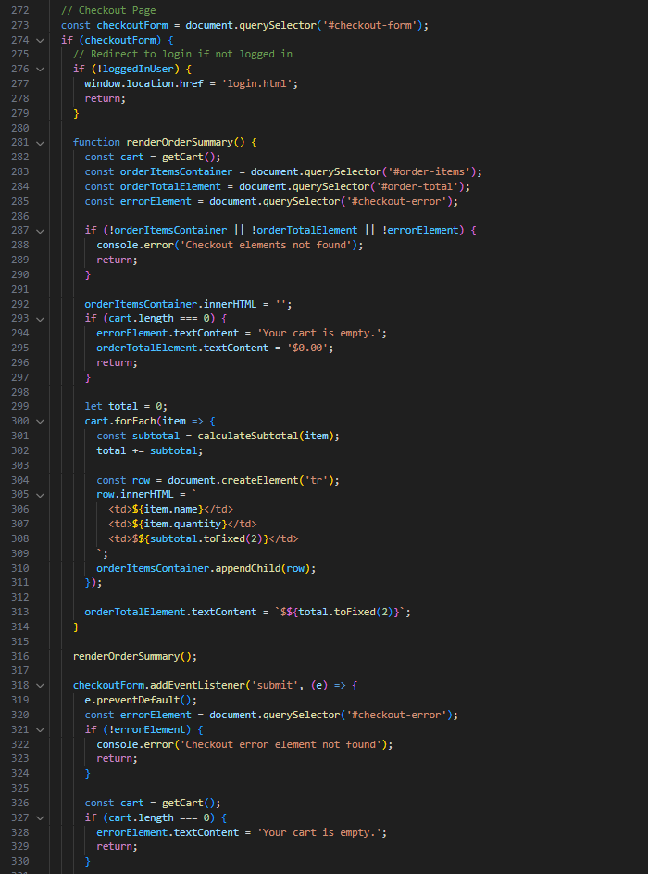
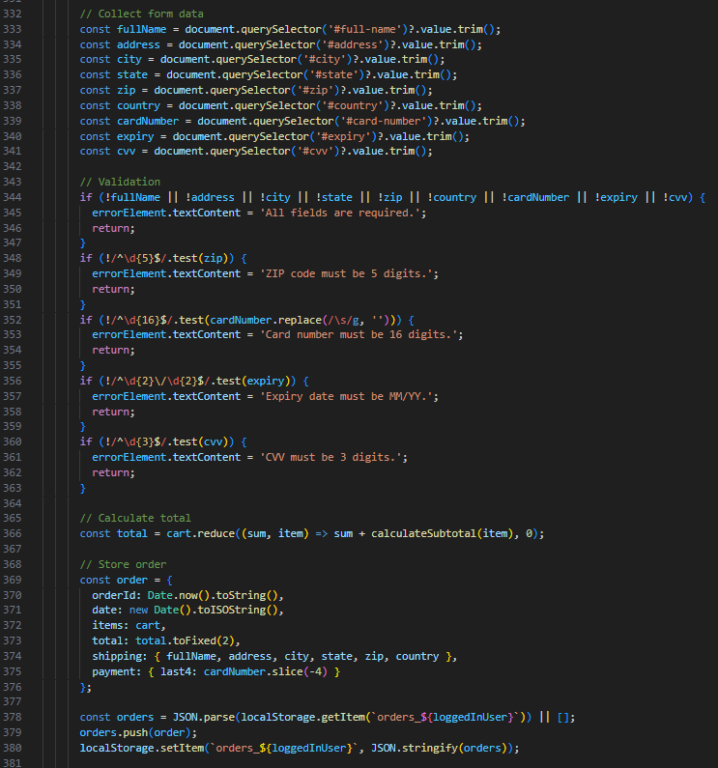
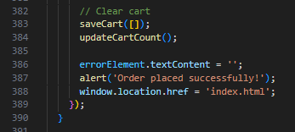

Slide 25
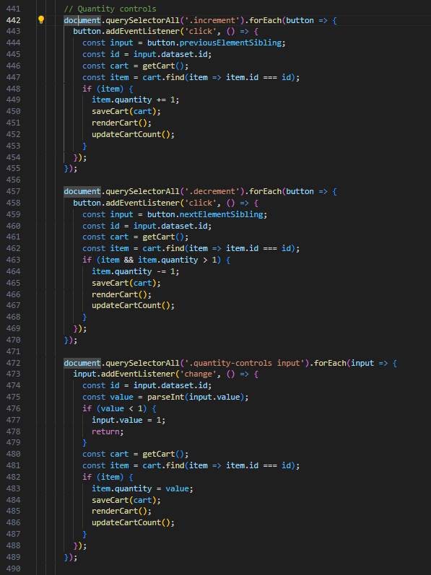
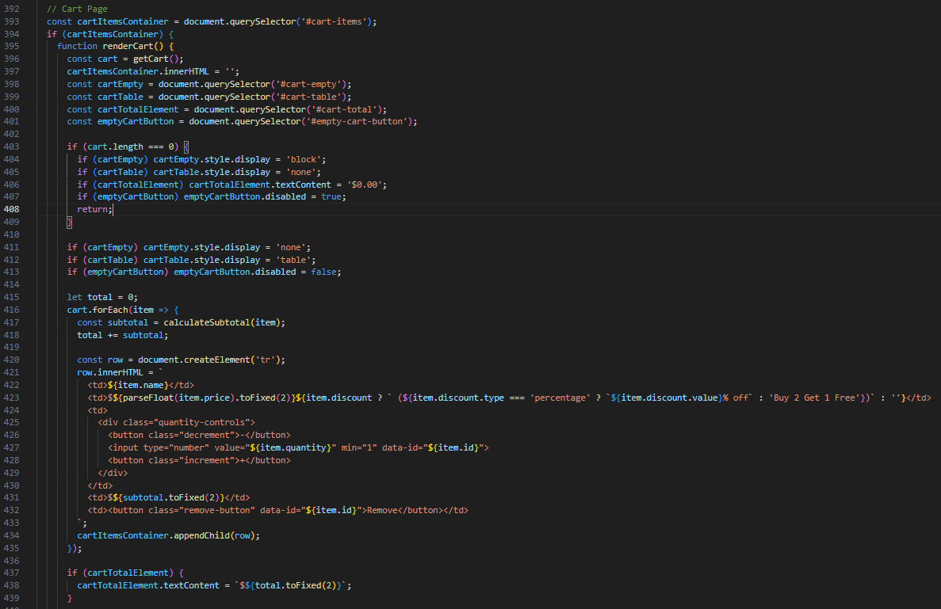

Slide 26
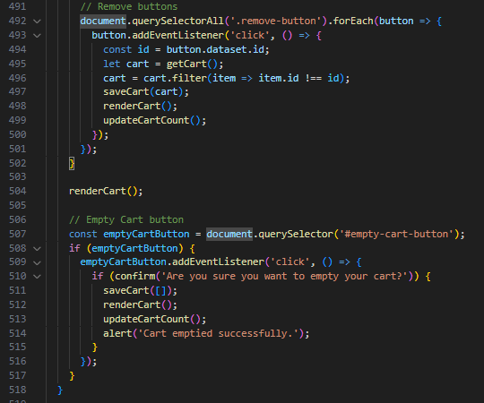
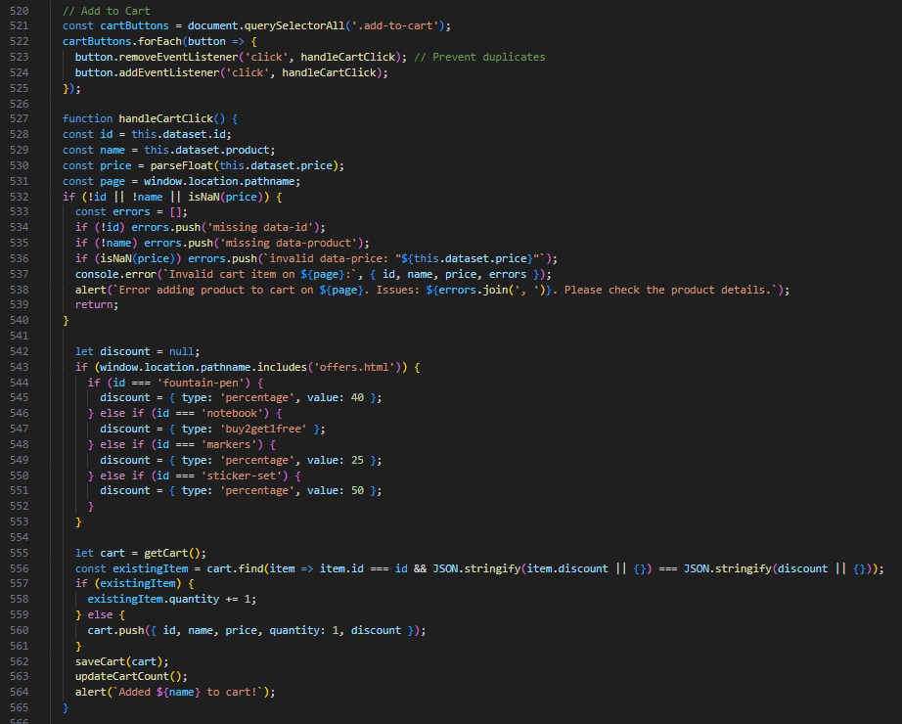

Slide 27
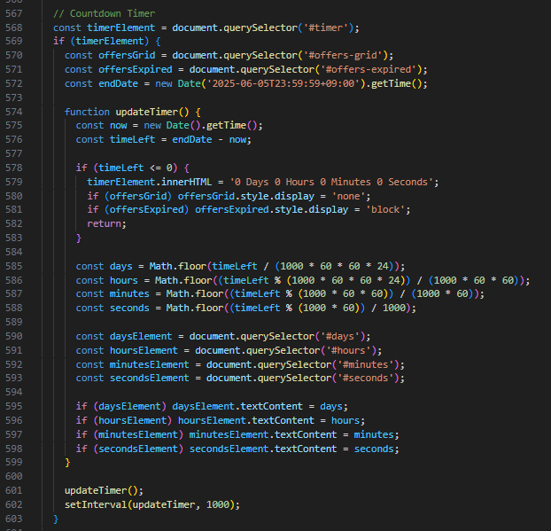
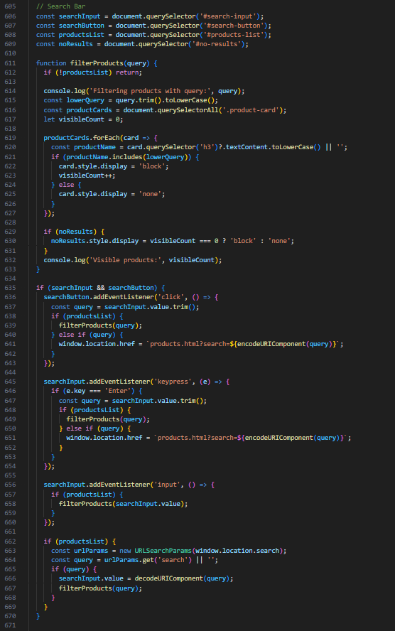

Slide 28
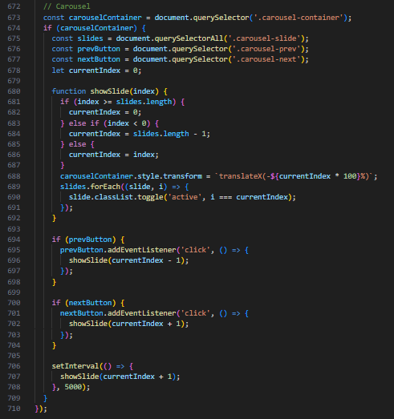
That’s the whole JS code☺

Slide 29
Mistakes
Hard coding features that could have been added in a much smoother manner.
Not saving a branch on Git while trying to implement certain features that I am not fully confident I can implement
(Example: I tried to integrate a mogoDB database instead of the local storage by JS and I ended failing to implement it and spend 3 hours trying to get back to the zero point ☹)

Slide 30
Cont’d
Not using a JSON file for product management from the first place. Even though fetching from a JSON file would make the JS code much harder and longer, I realized how important it’s after the products became many and I kept repeating steps that could have been much easier using a JSON file.

Slide 31
Lesson
Get out of my comfort zone (The JSON file example)
Make a Git branch and then try whatever I want
If something feels like hard-coding I must search for sth that makes the process easier

